Slide 1
eMMC
(Embedded Multi Media Card)
K.LOKESH
Chipweave Technologies Private Limited

Slide 2
Introduction
An embedded MultiMediaCard (eMMC) is a small storage device made up of NAND flash memory and a storage controller.
Designed primarily for portable devices such as:
Smartphones
Tablets
Both the flash memory and controller are contained on a single integrated circuit (IC).
The IC is permanently embedded (soldered) onto the device PCB.
Provides compact, low-power, and cost-effective storage for embedded systems

Slide 3
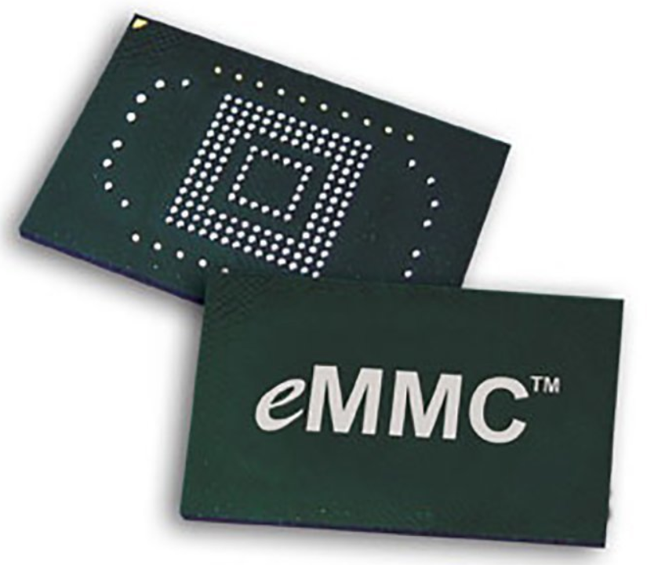
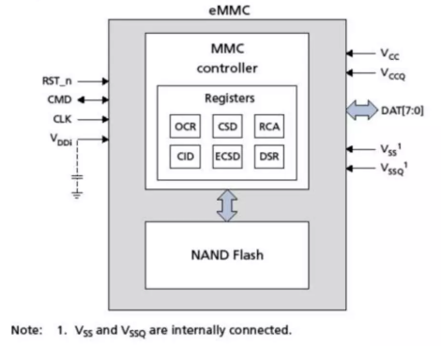
eMMC Block Diagram

Slide 4
How do eMMC Work?
An eMMC acts as the primary storage for portable and embedded devices.
That storage can be expanded with a removable Secure Digital (SD) card or microSD multimedia card in larger systems.
eMMC is the sole storage for very small sensors connected to IoT devices.
Connection & Architecture:
eMMC IC is directly soldered onto the device PCB
Communicates with the host using a parallel interface.
No external storage controller is required.
Role of the Integrated Controller
eMMC includes an internal controller and firmware
Handles:
Data placement
Wear leveling
Error correction
Reduces CPU workload, allowing the CPU to focus on application tasks

Slide 5
How do eMMC Work?
Power Efficiency
Uses NAND flash memory (no moving parts)
Consumes very low power, ideal for battery-operated devices
More energy efficient than spinning hard disks
Performance
Latest eMMC specifications support speeds up to 400 MB/s
Performance comparable to SATA-based SSDs
Suitable for embedded and mid-performance applications

Slide 6
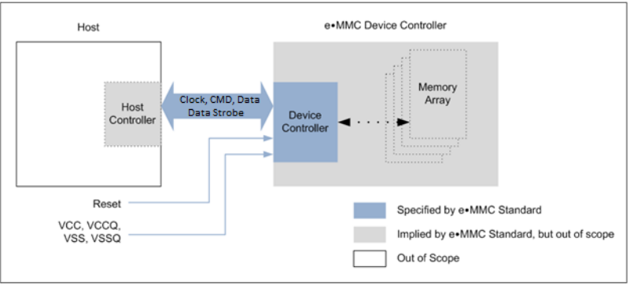
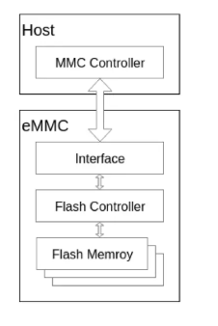
eMMC Architecture

Slide 7
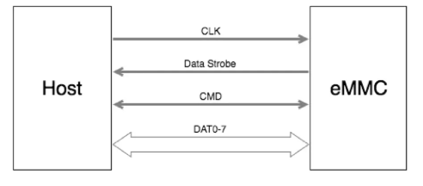
eMMC Bus protocol
CLK (Clock)
Host-generated clock used for data synchronization and device operation
Supports:
SDR (Single Data Rate) → 1 bit per clock cycle
DDR (Double Data Rate) → 2 bits per clock cycle (DAT lines)
Clock frequency is dynamically adjustable (0–200 MHz)
Enables power saving and flow control
Clock may be stopped in Busy state or Programming state

Slide 8
eMMC Bus protocol
CMD (Command Line)
Bidirectional command channel between Host and eMMC
Used for command transmission and responses
Operates as:
Open-drain during initialization
Push-pull mode for high-speed operation
DAT[0–7] (Data Lines)
Used for data transfer between Host and eMMC
After power-up/reset:
Only DAT0 is active
After initialization:
Data bus can be configured as 1-bit, 4-bit, or 8-bit
Pull-ups disconnected when lines are actively driven

Slide 9
eMMC Bus protocol
Data Strobe (DS)
Clock signal generated by eMMC (device → host)
Same frequency as CLK
Used for data capture synchronization
Available only in HS400 mode
Improves timing margin and stability
Eliminates the need for bus tuning
Mode Name | Data Rate | I/O Voltage | Bus Width | Frequency | Max Data Transfer
Backward Compatibility (Legacy MMC) | SDR | 3 / 1.8 / 1.2 V | 1, 4, 8 | 0 – 26 MHz | 26 MB/s
High Speed SDR | SDR | 3 / 1.8 / 1.2 V | 1, 4, 8 | 0 – 52 MHz | 52 MB/s
High Speed DDR | DDR | 3 / 1.8 / 1.2 V | 4, 8 | 0 – 52 MHz | 104 MB/s
HS200 | SDR | 1.8 V / 1.2 V | 4, 8 | 0 – 200 MHz | 200 MB/s
HS400 | DDR | 1.8 V / 1.2 V | 8 | 0 – 200 MHz | 400 MB/s

Slide 10
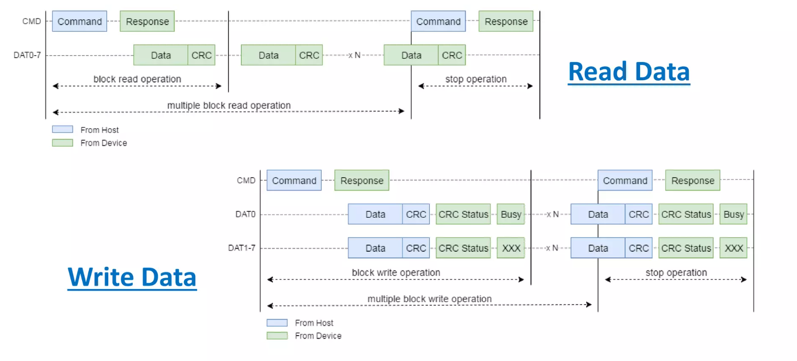
eMMC Bus protocol

Slide 11
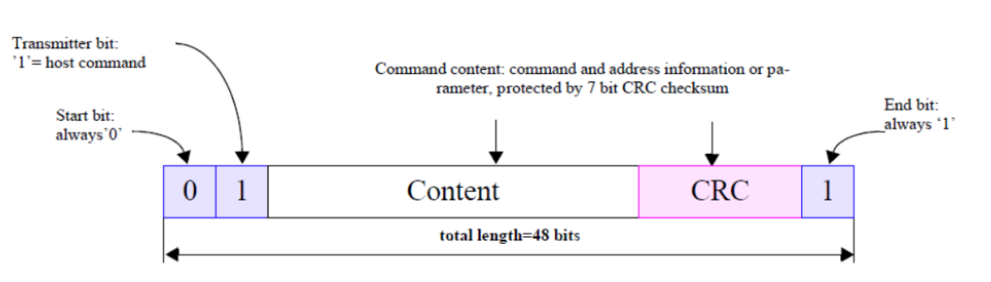
Command Token Format

Slide 12
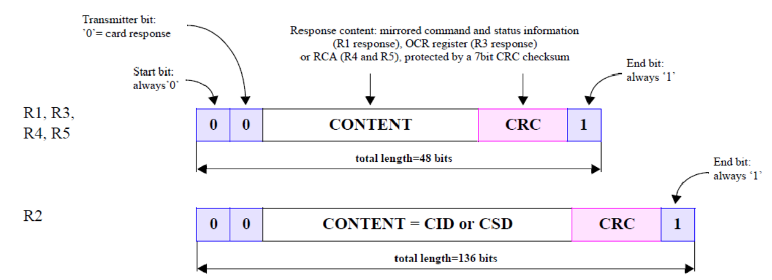
Response Token Format
CID: Card Identification number register
128-bit read-only register used for device identification
Contains unique identification information for each eMMC device
Used by the host during the card identification phase of the eMMC protocol
CSD: Card Specific Data register
Defines the access parameters of the eMMC device, including data format, error correction, timing, and transfer speed.

Slide 13
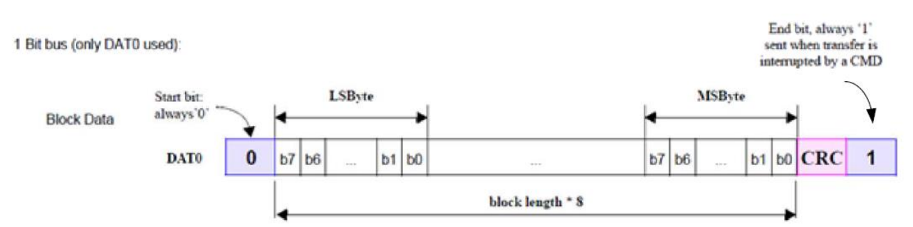
Single Bit Bus Data Packet Format for SDR

Slide 14
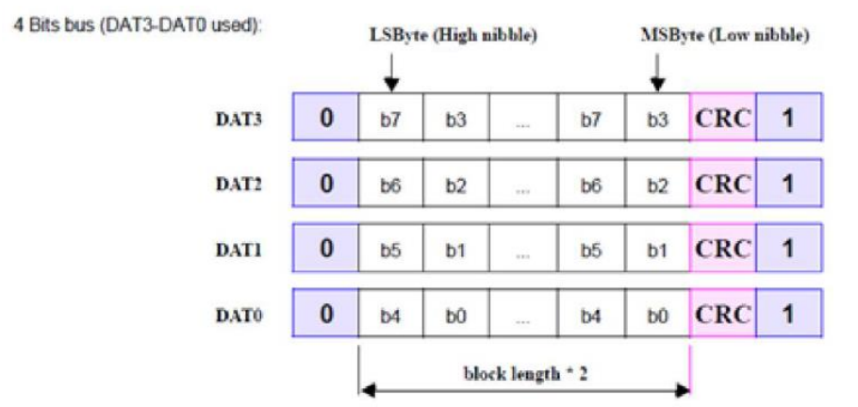
4 Bit Bus Data Packet Format for SDR

Slide 15
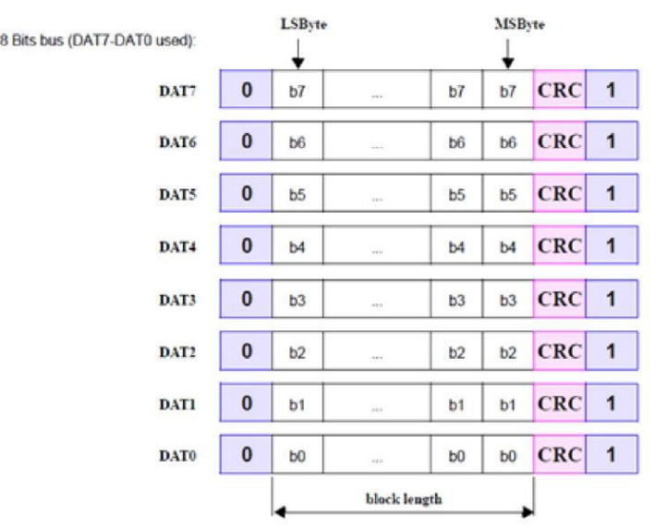
8 Bit Bus Data Packet Format for SDR

Slide 16
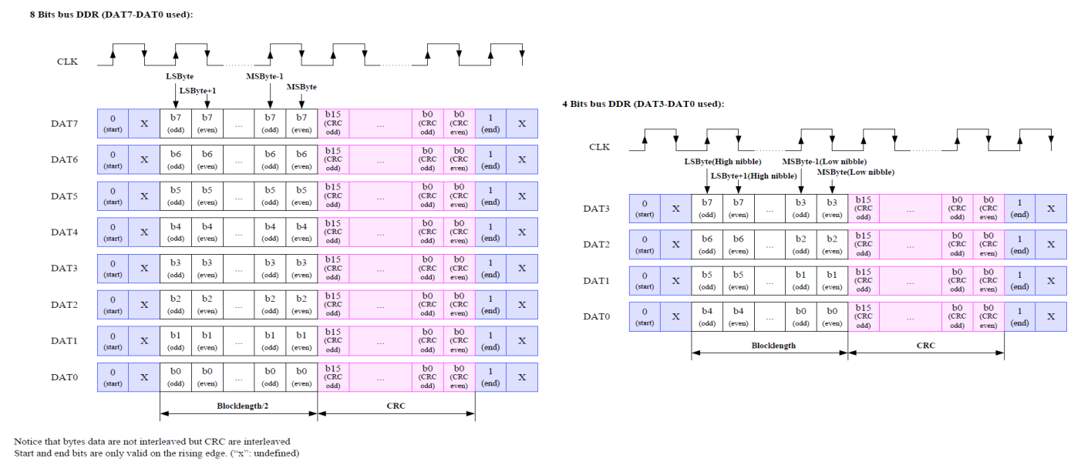
Data Packet Format for DDR

Slide 17
Use Cases for eMMC
Widely used in mobile devices such as smartphones, tablets, and lightweight laptops
Available in capacities up to 512 GB, offered by multiple vendors
Commonly used in IoT devices and sensors for compact, low-power data storage
Adopted in the automotive industry for infotainment and navigation systems
Ruggedized eMMCs are designed for industrial and automotive environments, offering higher reliability at increased cost

Slide 18
The advantages of eMMC technology
A large data storage capacity, up to 512 GB.
A compact form factor that makes it ideal for small consumer electronics and other electronic devices.
A low cost compared with other technologies.

Slide 19
Drawbacks of eMMC technology
A limited number of write cycles.
Not ideal for high-performance and compute-intensive applications.
Not as reliable as other architectures, such as SSDs.
Slower read/write speeds than technologies such as Universal Flash Storage (UFS) and non-volatile memory express.

Slide 20
Thank You !

